Slide 1
ISYE 6739 Project Final Report
Team 4: Lechen Yu, Sara Miller, Matt Gudorf, Luke Erlandson
Spring 2020

Slide 2

Introduction
As a group, we decided to analyze the current COVID-19 situation. We investigated the geographic and temporal spread of confirmed cases. The investigation was divided into four parts:
Study the effects of quarantine measures on COVID-19 growth rate
Analyze weather and geography’s effects on COVID-19 growth rate
Examine the distribution of doubling times of COVID-19 cases for a variety of countries
Investigate relationship between time and published estimates of COVID-19 basic reproduction number (R₀) in China

Slide 3
Raw data description
As part of our investigation, we used data sources including:
John Hopkins University Center for Systems Science and Engineering (JHU CSSE) [6]
United States National Library of Medicine (NLM) [1]
COVID-19 Testing Tracker. Foundation for Innovative New Diagnostics [4]
Variations in government responses. Blavatnik School of Government, University of Oxford [5]

Slide 4
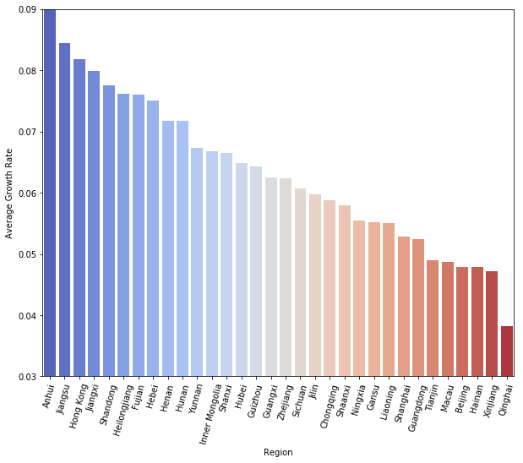
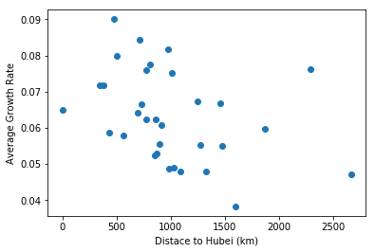
Effect of climate and location on COVID-19 growth rate
The average growth rate in each region is not normally distributed
WIth the increase of distance to Hubei, COVID-19’s growth rate decreases
The negative correlation has also been demonstrated by a negative covariance

Slide 5
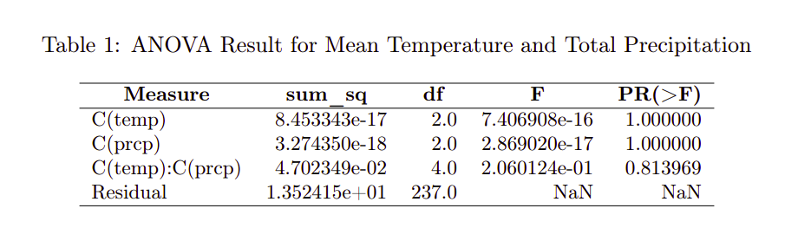
Effect of climate and location on COVID-19 growth rate
We tried to analyze the relationship between weather and COVID-19’s spread
We carried out ANOVA for each pair of weather data
The result indicates that weather has little effect on the spread of COVID-19

Slide 6
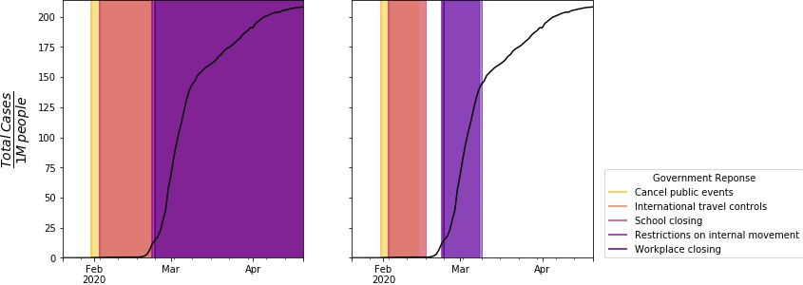
Effect of social distancing on COVID-19 growth rate
Identify most effective quarantine measures
Total cases per capita time series
Compare the growth rate before and after each quarantine measure, for each country.

Slide 7
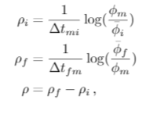
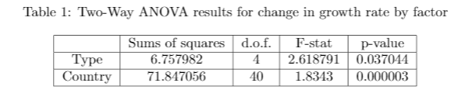
Effect of social distancing on COVID-19 growth rate
Assumed exponential growth
Use of 14-day averaging windows to attempt to incorporate incubation period
Two-way ANOVA shows that both quarantine measure and country effect the change in growth rates.

Slide 8
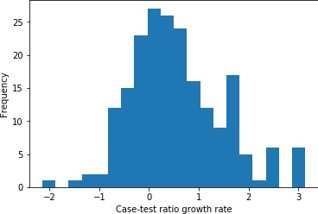
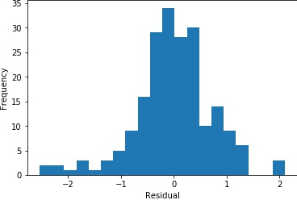
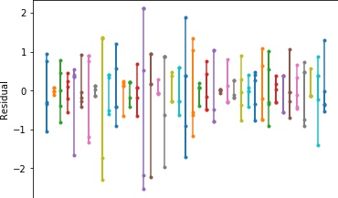
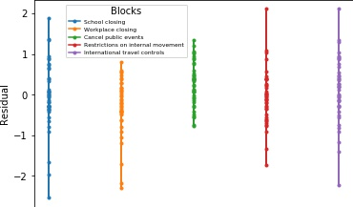
Effect of social distancing on COVID-19 growth rate
Approximately normally distributed values and residuals, and approximately equal variances for blocks (quarantine measures) but not treatments (countries).

Slide 9
Doubling time by country
By looking at the doubling time by country, we can get an idea of the distribution
We can get insight into which countries are growing quicker
We could use the doubling times to get an idea of how quick we expect it to grow

Slide 10
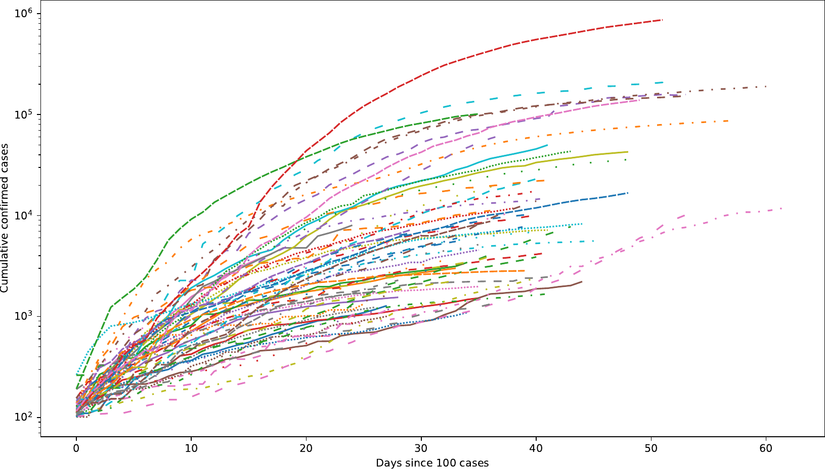
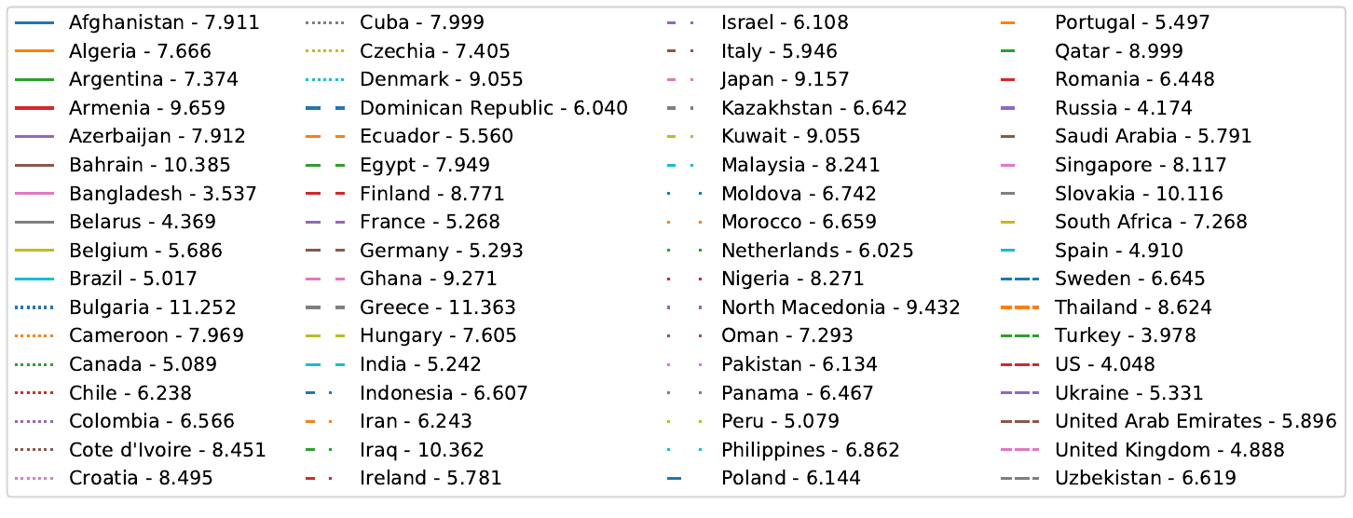
Doubling time by country
Observations on cumulative cases
We see that, unsurprisingly, the United States has the largest number of cases
Curves initially started out increasing faster, but most are flattening due to practices

Slide 11
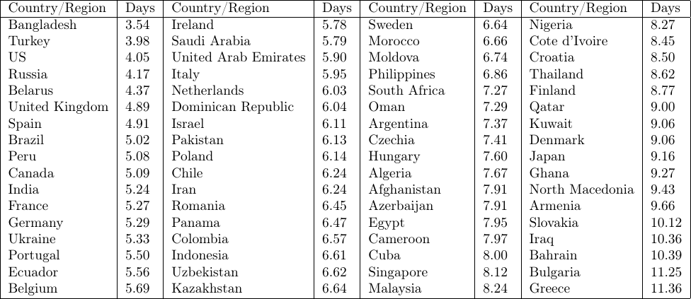
Doubling time by country
Observations on doubling times
Countries widely considered developed such as US, United Kingdom, Spain, Canada, France and Germany all are within the top quarter of quickly doubling
This may be due to more testing, density of population, or speed of response

Slide 12
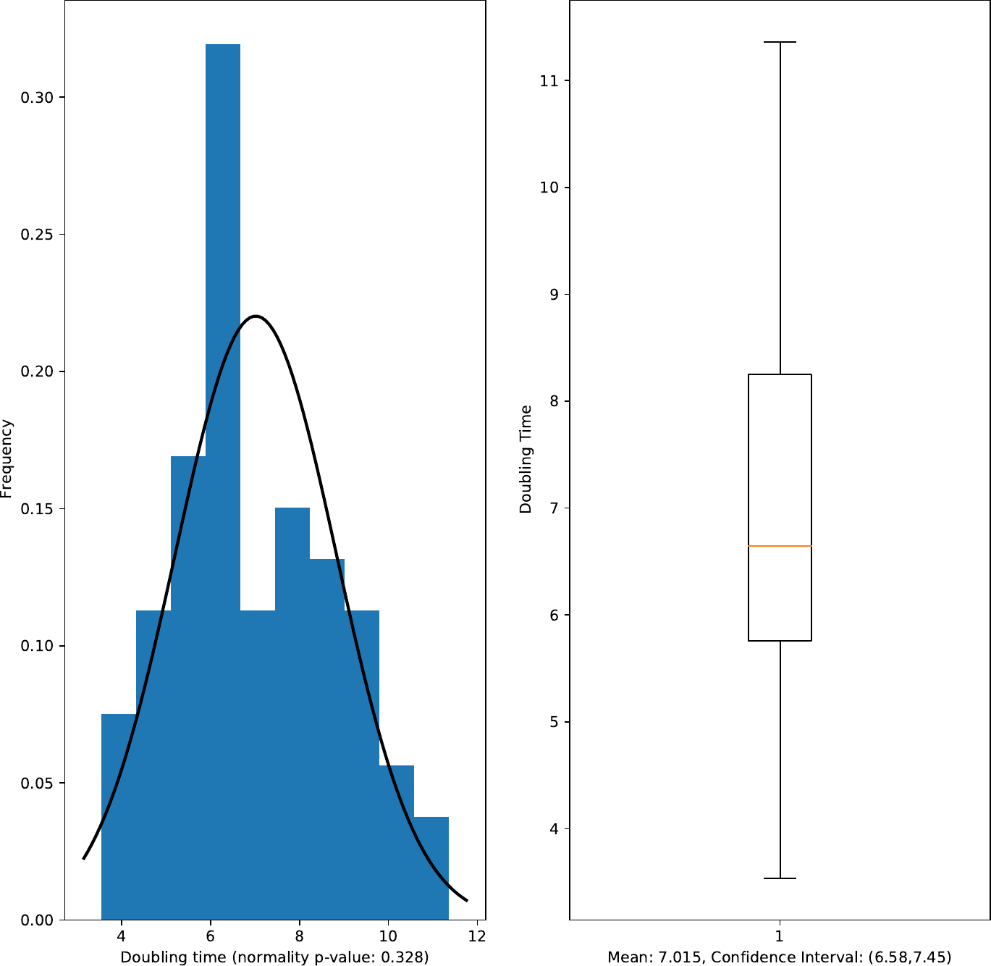
Doubling time by country
Observations on distribution
The doubling rates do follow a normal curve
This indicates methods of analysis that require a normal distribution could be used
There is a skew to lower doubling times
The found confidence interval aligns with some estimates in literature
[(A Systematic Review of COVID-19 Epidemiology Based on Current Evidence]

Slide 13
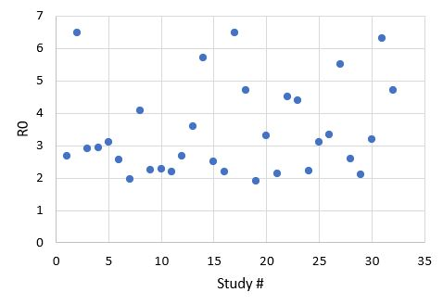
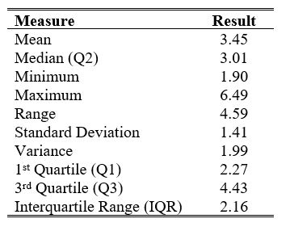
COVID-19 Growth Rate Meta-Analysis
R₀: average number of people who will contract a disease from one contagious person
R₀ > 0: number of infected people is likely to increase
R₀ < 0: transmission of the virus is likely to die out
Meta-Analysis
Growth of COVID-19 in China
32 published estimates for R₀

Slide 14
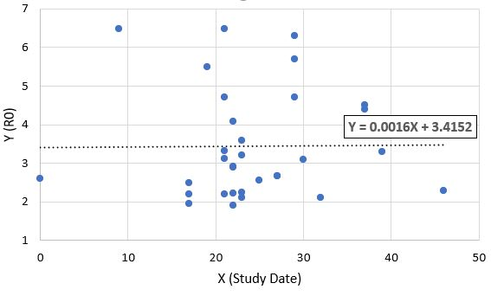
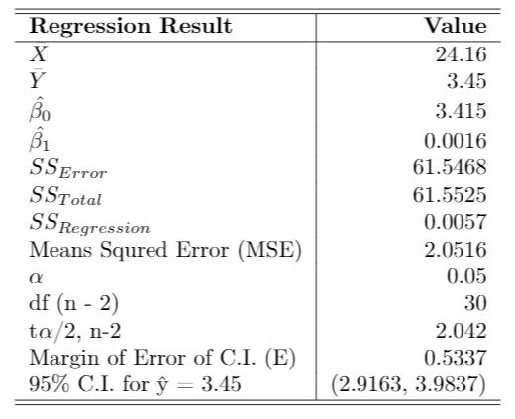
COVID-19 Growth Rate Meta-Analysis
Are published estimates of COVID-19 in China decreasing with time?
Chinese government ban on public transportation invoked on January 23, 2020 for five major cities (Wuhan, Huanggang, Ezhou, Chibi and Zhijiang) [2]
Simple Linear Regression
Predictor: Cutoff Date for COVID-19 Cases Reported (“Study Date”)
Response: R₀ Estimate

Slide 15
Summary
COVID-19’s growth rate in China is negatively correlated with the distance from Hubei.
The weather in China has little impact on the spread of COVID-19.
There are significant effects between different quarantine measures and the countries that implement them.
The doubling rates of COVID-19 appear to be normally distributed across countries.
Meta analysis shows no dependence of reproduction number on time

Slide 16
Future work and improvements
Wait for quantity and quality of data to increase
Further analysis of the spread of initial contagion in China to develop protocols for first responses to new diseases.
Find a way to handle the lack of independence between quarantine measures
Find and utilize methods which exploit normally distributed doubling rates
Continue meta-analyses to validate results.

Slide 17
References
[1] United States National Library of Medicine (NLM): https://www.ncbi.nlm.nih.gov/pubmed/
[2] BBC NEWS. Coronavirus: Wuhan Shuts Public Transport over Outbreak.
[3] Our World in Data. Joe Hasell, Esteban Ortiz-Ospina, Edouard Mathieu, Hannah Ritchie, Diana Beltekian and Max Roser https://github.com/owid/covid-19-data/tree/master/public/data/
[4] Foundation for Innovative New Diagnostics. COVID-19 Testing Tracker. https://finddx.shinyapps.io/FIND_Cov_19_Tracker/
[5] A. Petherick, T. Hale, T. Phillips, S. Webster, Variation in Government Responses to COVID-19. Preprint https://www.bsg.ox.ac.uk/research/publications/variation-government-responses-covid-19
[6] Johns Hopkins University Center for Systems Science and Engineering (JHU CSSE): https://systems.jhu.edu/

